Slide 1


Starting with Programming: Getting that developer job You want
by Martin Chaov

Slide 2

Hi, I’m Martin!
Tech enthusiast
Software architect
Ex-designer
...at least for me...

Slide 3

Who you might be?
Notes:
Who are you?
How many work as developers
How many want to change their jobs
How many want to start as developers

Slide 4


Slide 5
Agenda
Myths
9 to 5?
Passion
Find a dev job
Master the interview
Why people drop programming
Notes:
## Intro
This is a topic I wanted to do for a while. I have almost as much experience with interviews as I have with software development. I am not sure if that is a good thing... :D
This talk is going to cover:
Myths concerning the profession
Development as a 9 to 5 job
Development as a passion
How to find your development job
How to prepare for interviews
Why people drop programming
I am not perfect, some of the points I am going to make are going to be a bit controversial. Please be patient with me and try to understand the message.
Disclaimer: this is not a SBTech recruitment session, however I am going to be giving examples based on my experience there.
So you want to get a job in the software industry or you already have one, but you want better!
**Engage the audience:**
- Is it hard?
- How hard could it be?
- Why it is that hard?

Slide 6

Once upon a time…
Notes:
## Short story
**I want to start with a story:**
A young energetic and very talented guy decided to get into all that tech business.
He invested time and money in courses. There he learned some C#, some JS, HTML/CSS. A bit about .NET and IDEs and other tooling. Autogenerating MVC project and your job is practically done for you. Why are people complaining working as a developer is so tough?
In couple of months he was already thinking:
"Nice, if that is all there is - I should have went that road long ago."
He was doing okay in simple algorithms, and data structures. Struggling but with the help of tutorials he was eventually getting to the solution of the problems.
After few small projects pushed in github, he decided he is ready to take up on the job.
"Junior developer?" - he thought, "nah, I am too good for that... I already have few projects and helped my mom fix her laptop. I am ready for the big challanges..."
Then he went on a interview for junior developer. The questions were simple:
- Stack, list, queue...
- What is OOP?
- Garbage collection?
- What is MVC?
- What are the SOLID principles?
- Why did you do project X the way you did?
- How do you handle the user session? Why?
- Simple tasks to do for the interview...
Then there was a second similar interview... And a third one.
Eventually after a year the guy finds a junior position by learning all the answers to the interview questions :D Then he struggles to survive the first 6 months in the company...
Do you know people like that?

Slide 7

Notes:
## Real examples
### One
We used to send a simple task for HTML/CSS devs before interview. They had to do a simple two column layout where columns remain with the same height. I've read a comment from a rejected candidate which I am paraphrasing as such:
> "They are lying to the candidates. Sending this task, so they could get free work done for them. They gather all the layouts done and sell them as templates..."
We are a sports betting company. Our layout haven't changed in 12 years. It is still the same simple 3 column one. Do you know how we make money - we make money by selling numbers to people who want to buy them.
Think about it, the guy struggled to do a HTML layout, but non the less it was our company fault for not hiring him. We also stole his code to sell and make ton of money...

Slide 8

Notes:
### Two
In one interview I had to ask someone on how they develop their JS. Without too many details I had to re-phrase the question several times while the candidate was avoiding it. Eventually the answer was "on a keyboard"... This was the end of the interview with this self-proclaimed senior developer.

Slide 9

Notes:
## Myths
Let's discuss some of the myths I observed over the course of my career so far.

Slide 10
If you don't love programming, it's not for you!
Notes:
### If you don't love programming, it's not for you.
Not true. Many people dislike their professions but they were chosen because of economical reasons. (personal example: mom is a theatrical director, sells power tools) Programming is a viable well paid alternative for people who are willing to invest the time into learning it.

Slide 11
Developers work 1000000 hours a week!
Notes:
### Developers work XX hours weeks
No they don't.

Slide 12
The job is done when the code is delivered!
Notes:
### The job is done when the code is delivered
Commercially successful software may be used for decades. Developers must continually maintain such software: they add features and repair bugs. Maintenance costs predominate over all other costs; maintenance may be 70% of the development costs. This myth is true only for shelfware --- software that is never used, and there are no customers for next release of a shelfware product.

Slide 13
You can learn everything online!
Notes:
### The Youtube learner
Many young wannabe developers believe that online courses are a viable alternative to learning from books or universities. This is true for the base level knowledge only. Online you can get some basic algorithms, some language tips and tricks, basic knowledge of the tooling. Nothing more. Knowledge is power. No one is going to teach you for free on how to make money :)
That being said, there are many very good books on the subject that delve into detail on how to do software.

Slide 14
You can't assess software quality until the program is ready and running!
Notes:
### You can't assess software quality until the program is running.
There are static ways to evaluate quality without running a program. Software reviews can effectively determine the quality of requirements documents, design documents, test plans, and code. Formal (mathematical) analyses are often used to verify safety of critical software, software security factors, and very-high reliability software.

Slide 15
I need serious math skills to learn how to become a software developer!
Notes:
### I need serious math skills to learn how to become a software developer
Success as a programmer and math proficiency are not directly correlated.

Slide 16
I don't need math to become a developer!
Notes:
### I don't need math to become a developer
Well that is just not true. Everybody needs math. Developers just need it a bit more than in most other professions. Consider a simple for loop:
In many industries math is essential part of the core product development:
- eCommerce => taxes, wares, analytics
- Logistics => route planning, time tables, analytics
- Music/Video => Fourier transforms,
- Graphics => fluids animations, particle systems, physics engines, analytics, procedural generation
- Medical => prescription of medication, CAT scans, MRI
- Betting =>
- Blockchain => (ECDSA) elliptic curve digital signature algorithm
- Cryptography =>
- FinTech => to some degree all of the above :)

Slide 17
let array = [];
for(let i = 0; i < array.length; i++){
// Do stuff to every odd cell in the array
// what is an odd number
// how do you calculate odd number
}
Notes:
- eCommerce => taxes, wares, analytics
- Logistics => route planning, time tables, analytics
- Music/Video => Fourier transforms,
- Graphics => fluids animations, particle systems, physics engines, analytics, procedural generation
- Medical => prescription of medication, CAT scans, MRI
- Betting =>
- Blockchain => (ECDSA) elliptic curve digital signature algorithm
- Cryptography =>
- FinTech => to some degree all of the above :)

Slide 18
Equal pay for the same job title!
Notes:
### Equal pay for the same job title
This one is too complicated to answer exhaustively so let's frame that this is my personal opinion.
In a good capitalistic environment earnings should be a function of the personal skills, competences, and delivered value. Another way to say this is: if two people aren't the same, how do you expect them to be the same professionals? Programming is not an assembly line type of work, and cannot be treated as such. Developers are not producing N number of items per hour under a strict norm.
Let me give you an example with two junior developers.
First one has a 4 year university degree
Second one completed a 6 month training in a software academy
First one has no other work experience
Second one has been a trader for the past 3 years
Both doesn't have programming experience in a software company.
Both apply for the same junior developer position at a betting company.
Which one do you think is better suited for the job?
Who is going to be more valuable for the company?
I for one can promise you it is much harder to teach betting to a developer than it is to teach programming to a trader :)
I can promise you - after almost 10 years in SBTech, I still don't know how to calculate the point spread on a basketball game correctly.

Slide 19
The myth of the senior developer!
Notes:
### The myth of the senior developer
Nobody is paying a lot of money to developers who code very good ```for``` loops. All the skills one might have around that are what makes a professional valuable. Life/work experience increases your scope of competences. As I foreshadowed in the previous point: skills beyond programming are making for valuable professionals.
A senior developer in one company or technology might not be a senior in another. Seniority doesn't come with years. It is a function of knowledge. The more you know about the system you work on. The better you understand what it means to release a software product.
Furthermore, senior title in one technology or company might not be directly translatable to another one.

Slide 20
It is too late for me to become a developer!
Notes:
### It is too late for me to become a developer.
It’s never too late to change careers! While other factors might interfere with this decision. Human beings can acquire new skills at any age. Consider who were the first programmers... There were no schools of informatics. There were not universities teaching you computer science. There was no computer science. Think about that for a second!
The first programmers are the mathematicians, accountants, physicists, chemists, doctors, engineers, etc. They were regular people with various carriers that needed something to get calculated. Also after their tasks were done, these were the people who created the first computer games :)

Slide 21
There is so much I don’t know. I’m never going to learn all this!
Notes:
### There is so much I don’t know. I’m never going to learn all this!
I have studied Informatics in the university. However, I can't put my finger and pin point what is useful and what is not.
Over time I found out that I've used more or less most of the things I learned in the university. Some at the very start ... some much later when I got experienced enough to face challenges that require specific knowledge.
I also started teaching people how to program. One starts to understand how hard it is to make a good programming course when they try to do it. Consider how you can teach programming to people only know about Facebook and moving the mouse.

Slide 22

Notes:
People don't know how much they don't know...
Unknown unknowns - explain cycle of learning.
Your main goal is to convert unknown unknowns into know unknowns. From that point on it is much easier to go about development.

Slide 23
Notes:
People don't know how much they don't know...
Unknown unknowns - explain cycle of learning.
Your main goal is to convert unknown unknowns into know unknowns. From that point on it is much easier to go about development.

Slide 24
Notes:
People don't know how much they don't know...
Unknown unknowns - explain cycle of learning.
Your main goal is to convert unknown unknowns into know unknowns. From that point on it is much easier to go about development.

Slide 25
Notes:
People don't know how much they don't know...
Unknown unknowns - explain cycle of learning.
Your main goal is to convert unknown unknowns into know unknowns. From that point on it is much easier to go about development.

Slide 26
Unconscious
Conscious
Incompetence
Competence
Notes:
Martin M. Broadwell first articulated the model in his "four stages of teaching“
The Four Stages of Learning provides a model for learning.
It suggests that individuals are initially unaware of how little they know, or unconscious of their incompetence.
As they recognize their incompetence, they consciously acquire a skill, then consciously use it. Eventually, the skill can be utilized without it being consciously thought through: the individual is said to have then acquired unconscious competence.

Slide 27

Unconscious
Conscious
Incompetence
Competence
Notes:
Unconscious incompetence
The individual does not understand or know how to do something and does not necessarily recognize the deficit.
They may deny the usefulness of the skill. The individual must recognize their own incompetence, and the value of the new skill, before moving on to the next stage.
The length of time an individual spends in this stage depends on the strength of the stimulus to learn.

Slide 28

Unconscious
Conscious
Incompetence
Competence
Notes:
Conscious incompetence
Though the individual does not understand or know how to do something, they recognize the deficit, as well as the value of a new skill in addressing the deficit.
The making of mistakes can be integral to the learning process at this stage.

Slide 29

Unconscious
Conscious
Incompetence
Competence
Notes:
Conscious competence
The individual understands or knows how to do something.
However, demonstrating the skill or knowledge requires concentration.
It may be broken down into steps, and there is heavy conscious involvement in executing the new skill.

Slide 30

Unconscious
Conscious
Incompetence
Competence
Notes:
Unconscious competence
The individual has had so much practice with a skill that it has become "second nature" and can be performed easily.
As a result, the skill can be performed while executing another task. The individual may be able to teach it to others, depending upon how and when it was learned.

Slide 31

How big a tech stack could be?
.NET
.NETCore
Adobe Suite
Aerospike
Amazon AWS
Android
Artifactory
ASP.NET
ASP.NETCore
Azure
Bitbucket
C#
Cake
Catchpoint
CloudFlare
Confluence
Consul
CSS
Docker
Elastic search
F#
Fabio
Flink
Git
Google Cloud
Grafana
Helm
HTML
IIS
Incapsula
InfluxDB
iOS
Java
JavaScript
Jenkins
Jira
jQuery
Kafka
Kibana
Kong
Kubernetes
LESS
Linux
Logstash
Maven
MobX
MongoDB
MSSQL
Nginx
NodeJS
NPM
NuGet
Office 365
OSX
PostgreSQL
PRTG
RabbitMQ
ReactJS
SQLite
TypeScript
Vagrant
Vault
VBScript
Webpack
Windows
Notes:
#### Example with SBTech tech stack
This is a part of our tech stack. Treat it like a high level overview, there are more libraries, tools, and frameworks hiding between these words.
.NET, .NETCore, Adobe Suite, Aerospike, Amazon AWS, Android, Artifactory, ASP.NET, ASP.NETCore, Azure, Bitbucket, C#, Cake, Catchpoint, CloudFlare, Confluence, Consul, CSS, Docker, Elastic search, F#, Fabio, Flink, Git, Google Cloud, Grafana, Helm, HTML, IIS, Incapsula, InfluxDB, iOS, Java, JavaScript, Jenkins, Jira, jQuery, JSX, Kafka, Kibana, Kong, Kubernetes, LESS, Linux, Logstash, Maven, MobX, MongoDB, MSSQL, Nginx, NodeJS, NPM, NuGet, Office 365, OSX, PostgreSQL, PRTG, RabbitMQ, ReactJS, SQLite, TypeScript, Vagrant, Vault, VBScript, Webpack, Windows
No one in our company knows all of the above. It is inhumane. However it is good to have a general idea what is being used in which department. You can always advise with them, whenever you need something covered by their expertise.

Slide 32

What’s a developer?
Notes:
## What it is to be a developer?
Good question, everywhere it is a bit different.
Knowledge of a language is just the tip of the iceberg. Where people tend to loose grip on reality and get lost is everywhere else.
Nice, now you know JavaScript... amazing. It seems you can do only some data structures, and algorithms.
To make software it looks like you are missing critical knowledge…
What is that knowledge?
- LIBRARIES => what lib does what, React, Angular... etc.
- TESTING FRAMEWORKS => how to automate the testing of your code as the project grows
- BUILD TOOLS => wut? build tools?
- PACKAGING SYSTEMS => packaging, what is there to package - I can zip it, no?
- INLINE DOCS SYSTEMS => who needs documentation, people can read the code
- DOC HOST SERVICES => hosting the docs? why?
- CODE-HOSTING SERVICES => I need to put my code where to make it useful?
Wow ... so where do I start?
Let's try to explore the different types of developers based on work/life balance, not based on technology.

Slide 33
What’s missing?
Libraries
Frameworks
Testing
Build tools
Packaging systems
Inline doc systems
Code hosting services
Notes:
What is that knowledge?
- LIBRARIES => what lib does what, React, Angular... etc.
- TESTING FRAMEWORKS => how to automate the testing of your code as the project grows
- BUILD TOOLS => wut? build tools?
- PACKAGING SYSTEMS => packaging, what is there to package - I can zip it, no?
- INLINE DOCS SYSTEMS => who needs documentation, people can read the code
- DOC HOST SERVICES => hosting the docs? why?
- CODE-HOSTING SERVICES => I need to put my code where to make it useful?
Wow ... so where do I start?
Let's try to explore the different types of developers based on work/life balance, not based on technology.

Slide 34
What type of developer do you want to be?
Notes:
## Learning how to be the developer you want to be
What type of developer you want to be?
- 9 to 5
- SaaL -> software as a lifestyle

Slide 35

Coding as a 9 to 5 job
Notes:
### Developer as a 9 to 5 job
If you are aiming at a 9 to 5 job you are probably considering working in a company.

Slide 36

What is a company?
A company is made up of people, for carrying on a commercial or industrial enterprise.
It’s members share a common purpose, and unite to focus their various talents and organize their collectively available skills or resources to achieve specific, declared goals.
voluntary associations, which may include nonprofit organizations
business entities with an aim of gaining a profit
financial entities and banks
Notes:
#### What is a company
A company is made up of an association of people, be they natural, legal, or a mixture of both, for carrying on a commercial or industrial enterprise. Company members share a common purpose, and unite to focus their various talents and organize their collectively available skills or resources to achieve specific, declared goals. Companies take various forms, such as:
- voluntary associations, which may include nonprofit organizations
- business entities with an aim of gaining a profit
- financial entities and banks
This is not a place where you have a boss ... this is a group of people united under common goals.

Slide 37
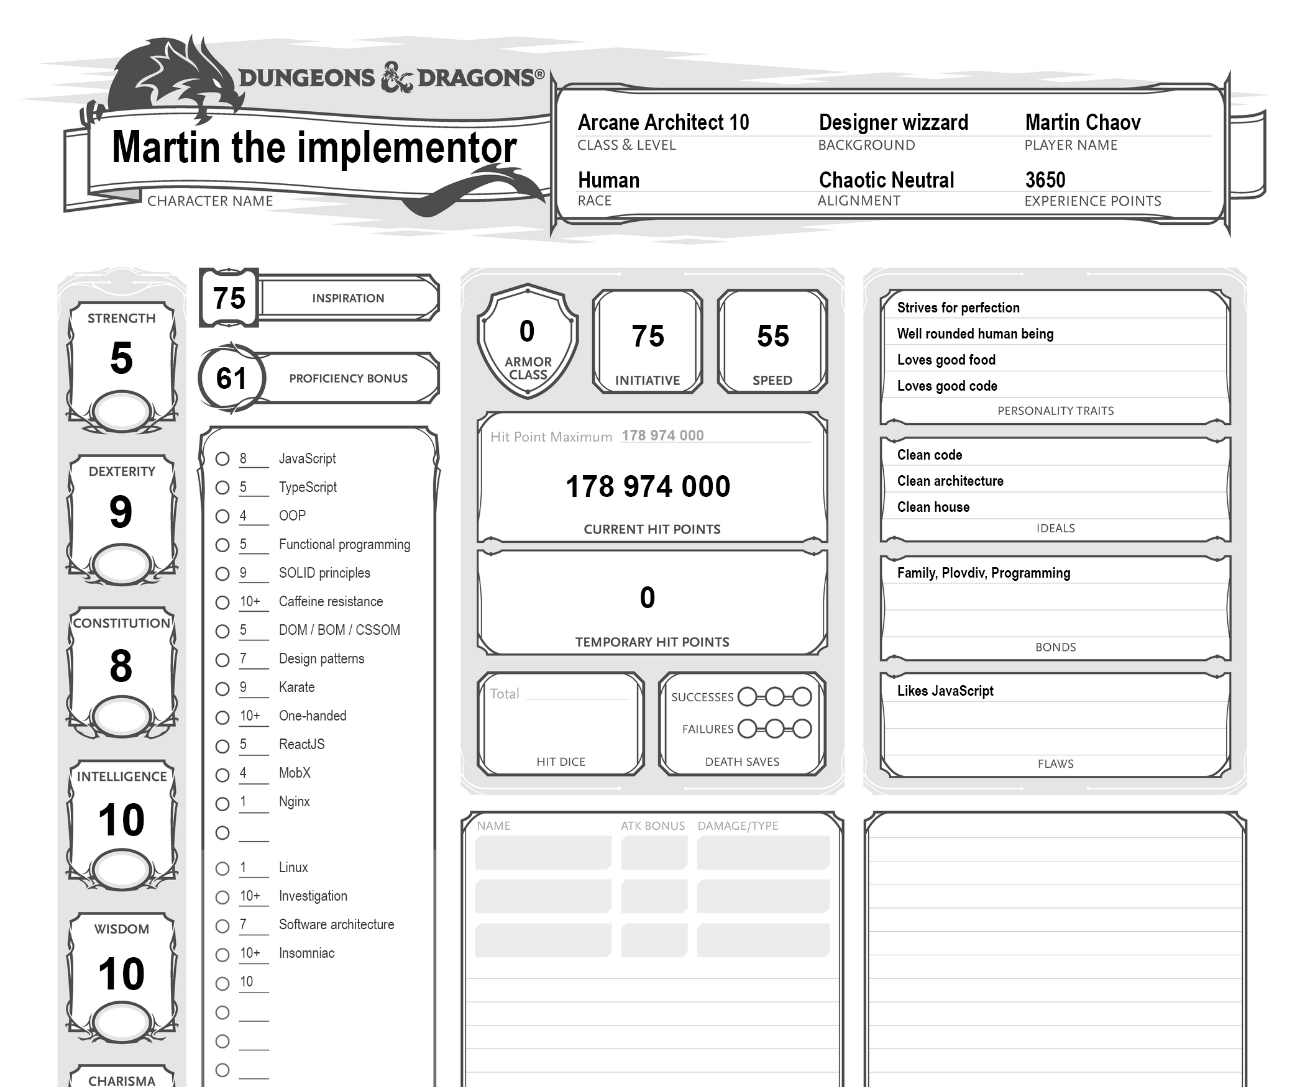
Notes:
Let me get something out first. Keeping your skills set sharp is on you, not on the company. Do not expect someone else to be responsible for your own personal/professional development. As we described company above - this is a place where individuals contribute their skills to gain profit. Skills === Profit.
You should not be spending your work hours on video tutorials or books. Your working hours are to bring value to your company.
Learning new skills can be part of your job if the project you get includes new technology or it requires research prior to working on the tasks.
In many companies there is a practice of reserving some time for personal growth. Some examples:
- send people to conferences
- organize internal trainings
- certification programs
- evaluations and setting personal goals
If you manage:
- your knowledge and competences well
- deliver your software on time
- deliver with quality
- have good manners
You are going to be a valuable professional. And that is going to be enough to have a 9 to 5 job as a developer in any company.

Slide 38

Notes:
#### And what is your job going to be?
"Your experience may vary"... The regular 9 to 5 job is going to be mainly plugging someone else's code into existing systems. Writing unit tests, estimating effort needed for completing your tasks. More or less the experience is going to be the same regardless of the business of the company. The passionate developers might see this as boring, but make no mistake - this is very valuable for companies. Developers who get bored fast and often leave to seek other challenges are rarely becoming valuable professionals.

Slide 39

Notes:
### Developer as a passion
"Your experience may vary". What is a passion? It is a "strong and barely controllable emotion". How could development be a passion?
Consider this. You start your computer. Open and empty file. Start writing text. Few hours later there is an animation on the screen. You created something, from nothing. This is art. Many other programmers may create/achieve the same "animation". All of them are going to do it in a different way, different language, different platform.
This is amazing.
Consider this - creating a simple function, that solves problems for thousands of other developers.
Example with "lodash"
- 2 137 291 downloads ... weekly
- 0 dependencies :D
- 78 154 packages depend on it
- 8 people
- 104 version releases over 7 years
- Free...

Slide 40
(skills: number, attitude: number, experience: number): number =>
Array.prototype.reduce.call(
arguments,
(a, b) => a + b, 0
) / arguments.length * 100
Notes:
If that is what you love to do, doesn't mean you are going to be successful.
If we define success as a function the input parameters are going to be:
```success(attitude, skills, experience) => number [0, 1]```
Very often passionate developers get in a endless loop of perfecting the same piece of code until they achieve nirvana.
Nirvana never comes...
When you are a part of a company you need to be aligned in terms of personal and company goals. Your internal craving for perfection or new technology should not compromise the company you are in.

Slide 41
What could you do in a company?
Research
POC
New product development
Notes:
#### What could you do in a company?
Research/innovations departments. Some of the larger enterprises have dedicated units that do only research of new technology and innovative products. If technology is a passion for you, and you have a field you feel interested in, this could be a very interesting career.

Slide 42

Notes:
## How to find your development job
Alright you decided what you want to do... what now?

Slide 43

Notes:
### Meet people at conferences
Since you are already here, I am going to skip this step :D
Also this is a great way to convert some of the unknown unknowns into known unknowns!

Slide 44
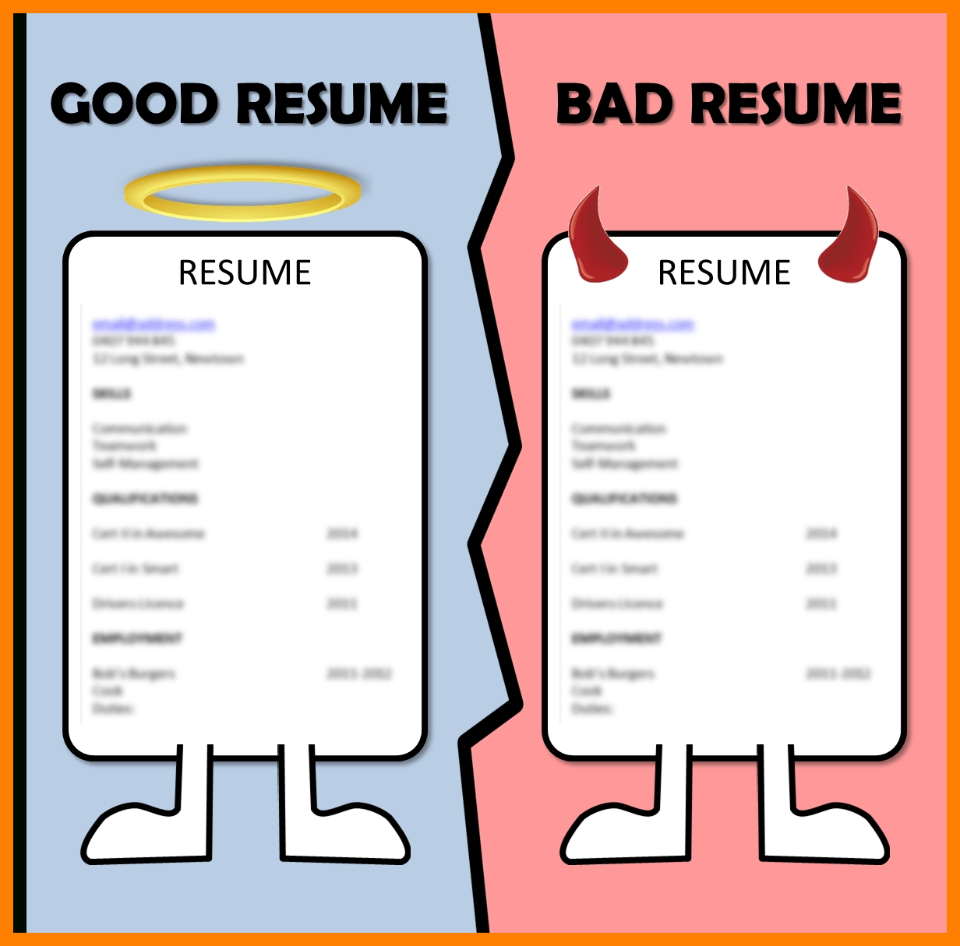
Get your CV ready
Notes:
### Getting your CV ready
Prepare your CV. Forget the free services of random companies. Make a focused CV based on what you want to do.
Don't :
- lie
- make bold claims
- just throw random text
- put % bars and star ratings
- use "bad" words
- show emotion
Do
- explain what you have worked on
- present your real skills
- organize well
- write cover letter
- show interest in the company/business
- be objective about your skills and shortcomings

Slide 45
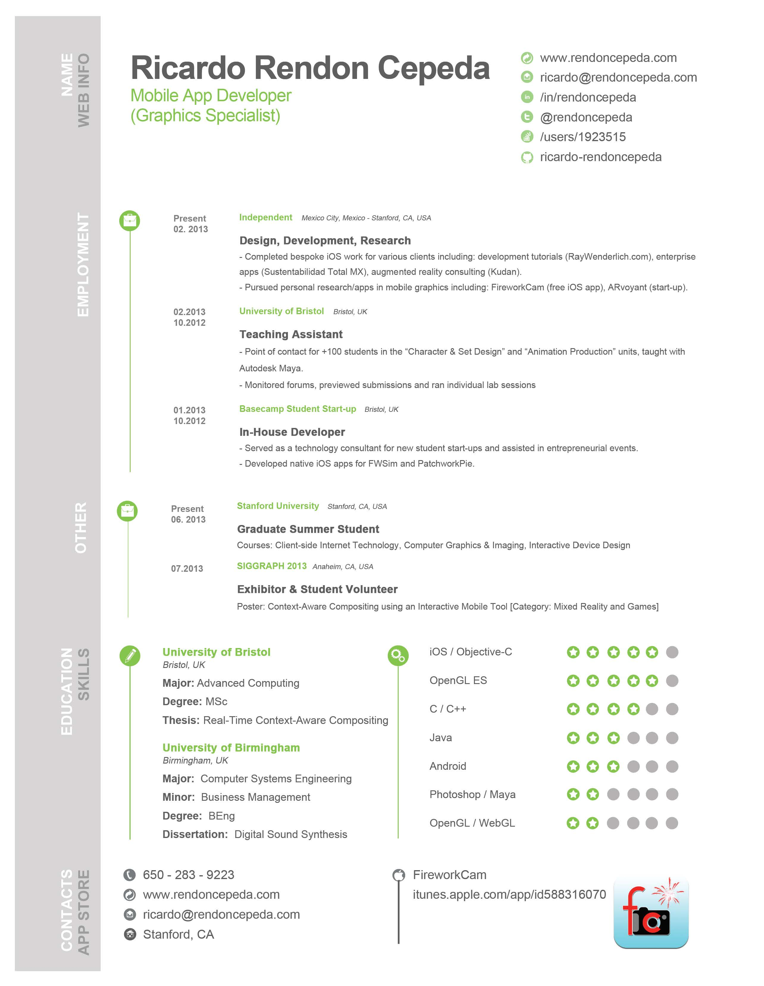
Notes:
Don't :
- lie
- make bold claims
- just throw random text
- put % bars and star ratings
- use "bad" words
- show emotion
Do
- explain what you have worked on
- present your real skills
- organize well
- write cover letter
- show interest in the company/business
- be objective about your skills and shortcomings

Slide 46
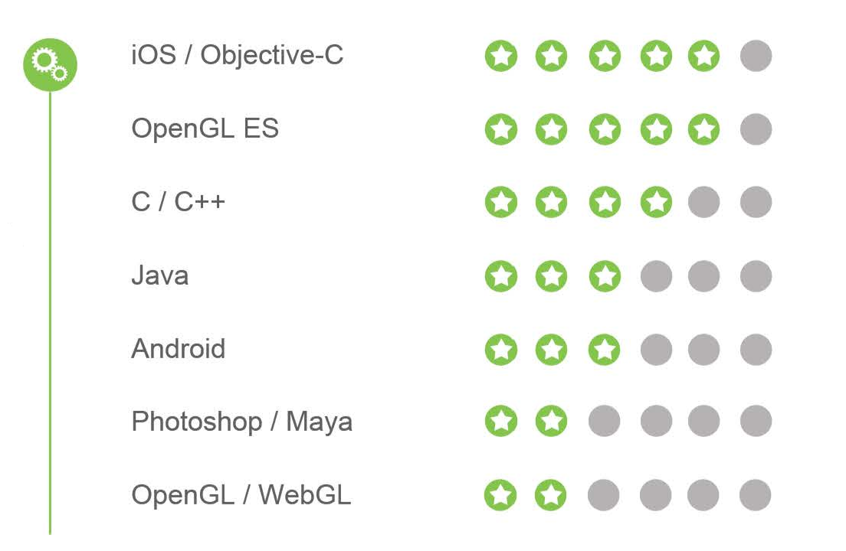
Notes:
Don't :
- lie
- make bold claims
- just throw random text
- put % bars and star ratings
- use "bad" words
- show emotion
Do
- explain what you have worked on
- present your real skills
- organize well
- write cover letter
- show interest in the company/business
- be objective about your skills and shortcomings

Slide 47

Notes:
Don't :
- lie
- make bold claims
- just throw random text
- put % bars and star ratings
- use "bad" words
- show emotion
Do
- explain what you have worked on
- present your real skills
- organize well
- write cover letter
- show interest in the company/business
- be objective about your skills and shortcomings

Slide 48
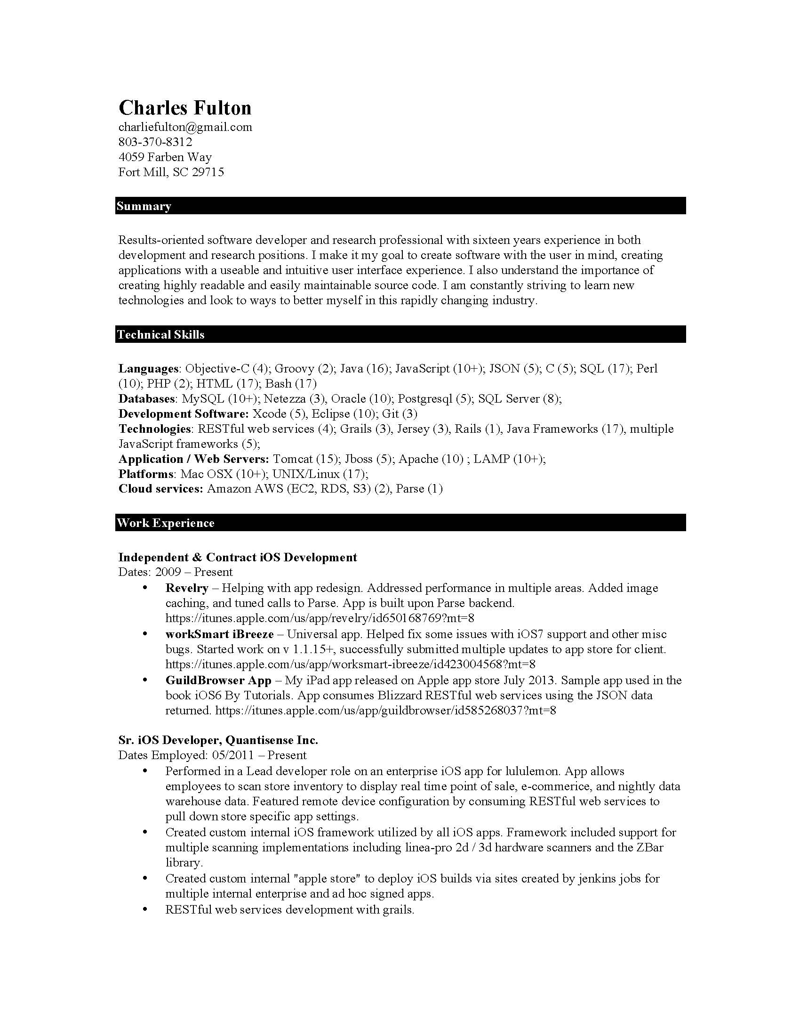
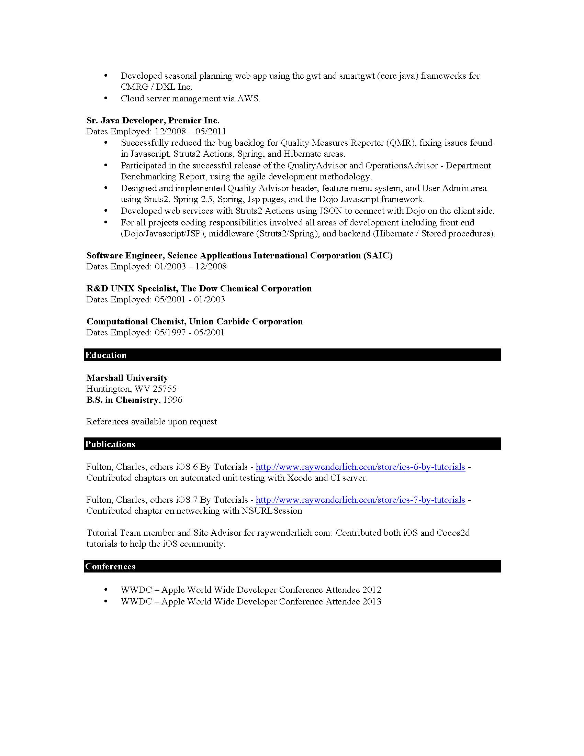

Slide 49

Notes:
Bad words:
Creative
Organizational
Effective
Extensive experience
Track record
Motivated
Innovative
Problem solving
Communications skills
Dynamic
Good words:
Designed and implemented XXX
Built XXX
Gained promotions because of XXX

Slide 50
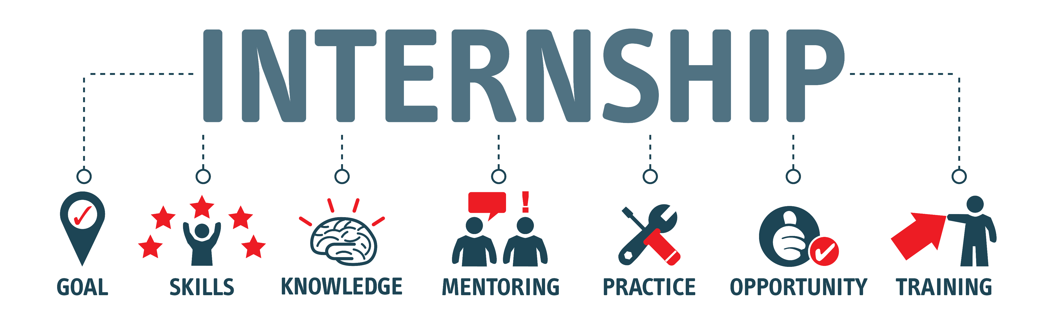
Notes:
### Internships
If you have some basic programming skills and want a quick entry - internships are a good way to start... if you can find one. The competition there is massive and only the best get them...

Slide 51

Notes:
### Research the company
When I say that, don't just google for random opinions around the web.
What to research:
- What is the business
- What is/are the products
- Where your skills and interests merge with the business
- How are they developing software: Agile, SCRUM

Slide 52

Notes:
### Apply for the position you want
Make a clear statement what you want and why you should get it.

Slide 53
Interview behavior
Notes:
### Interview behavior
Come prepared for the interview to the interview:
- well dressed
- clean...
Be ready for technical interview.
Be ready to show what you know in practice.
Data structures, loops, arrays, OOP principles, scope and context, SOLID... these are more or less all the things you need to be prepared to explain or demonstrate.
What we observe in recent time is that people who come to interview can't explain what they're are working on (either in prev company or now). If you can't explain what you are doing, be prepared to get rejected.
Be humble and realistic, both in your expectations and requirements.
Especially pseudo senior devs, often times are coming to the interview to fight. They want everything offering nothing but their word. Think about this from the other side. If you are hiring a guy to your team:
- How hard are you going to test him to make sure he is going to be a good fit?
- Are you going to demand some real proof of his skills?
- Are you going to challenge his salary based on the skills he offers?
Developer's pride - why do you verify his knowledge, it is written in his CV.
Last but not least:
- ask questions

Slide 54

Notes:
Use the right posture
What to do with your hands
Be aware of your legs
Eye contact
Monitor your voice
Understand the interviewer’s body language

Slide 55

Why do people quit programming?
Notes:
## Why people drop programming
And last but not least, let's quickly cover on why people give up on programming:

Slide 56

Notes:
### Copy/paste driven development
Juniors often times feel like they cannot get anything done. Their work experience can be summed up as: google search -> stackoverflow -> copy/paste -> git add/commit/push. This is a side effect of the learning method employed. Our minds tend to play games on us. We think that we understand what we see. It turns out that more often than not, we don't.
Especially when we are working in front of a PC, online courses are being polluted by chats, social media and other stuff one could do. This is not a viable learning experience.
This type of learning and attitude towards development give you false sense of mastery that goes away the moment you loose internet connection. Once you get into a room of colleagues and have to discuss implementation, your lack of knowledge is going to be detrimental to your self-esteem.

Slide 57


Constant inability to solve problems
Notes:
### Constant inability to solve problems
If the first urge you get when you see a task/problem is to google separately every single word of it, you are going to very quickly demotivate.
This is where the known unknowns comes into play. The ideal situation for 9 to 5 job is when you face problems composed of known knowns and known unknowns.

Slide 58

I just can’t think like a programmer
Notes:
### I just can’t think like a programmer
Guess what ... nobody thinks like a programmer. Programming is creative. Everybody has different creative process. The foundation and tools are very important. As artists use techniques to convey shadows, and use different types of paint and brushes and etc.; you need to become a master of the tools.
Tools are not only a PC, keyboard and a mouse, but also:
- Data structures
- Algorithms
- Libraries
- Frameworks
- Build tools
- Package managers
- etc...

Slide 59
Summary
Notes:
## Summary
- Myths concerning the profession
- Development as a 9 to 5 job
- Development as a passion
- How to find your development job
- How to prepare for interviews

Slide 60
Summary
Myths concerning the profession
Development as a 9 to 5 job
Development as a passion
How to find your development job
How to prepare for interviews
Notes:
## Summary
- Myths concerning the profession
- Development as a 9 to 5 job
- Development as a passion
- How to find your development job
- How to prepare for interviews

Slide 61

Notes:
## The end
Programming is hard, working as a developer is also hard work.
The level of satisfaction of creating something that touches the lives of millions of people is priceless...

Slide 62

Connect ☺
LinkedIn: https://goo.gl/CRRJ2Y
Mail: martin.c@sbtech.com
Github: https://github.com/mchaov
@raziel_pld

